Slide 1
Messy Data: Cleaning,
Correlation & Visualisation
MSE-803 Data Analytics | Week 3 — Activity 2
Hiruni Wickramasinghe
MSE-803 Data Analytics | Yoobee College

Slide 2
Problems Found in Raw Data
# | Problem | Example | How Fixed
1 | Duplicate row | Bob appears 2 times | Second Bob removed
2 | Missing Age (×2) | Empty cells | Filled with median: 29
3 | Missing Salary (×2) | Empty cells | Filled with median: $62,000
4 | Age written as word | "thirty-eight" | Converted to 38
5 | Salary written as word | "sixty five thousand" | Converted to 65,000
6 | Broken date | 2019-13-01 (month = 13!) | Marked as Unknown
7 | Missing Join Date | Empty cell | Marked as Unknown
8 | Missing Name | Empty cell | Filled as Unknown
9 | Missing ID | Eve has no ID | Assigned ID: 6
10 | Missing Country | Empty cell | Marked as Unknown
Before: 10 rows with many problems → After: 9 clean rows ✓

Slide 3
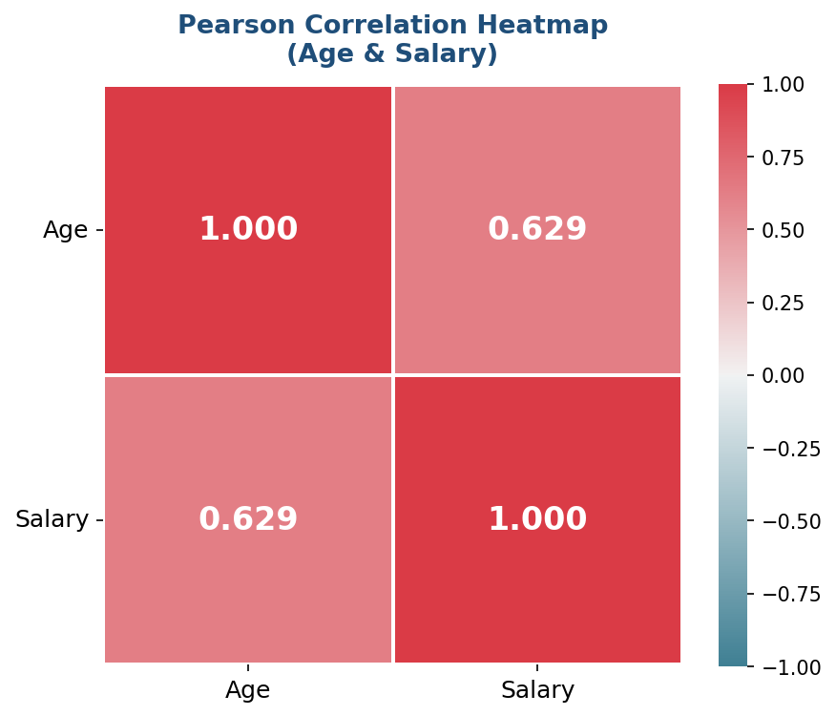
Pearson Correlation — Age vs Salary
r = 0.629
Moderate Positive Correlation
+1.0 Perfect positive
+0.7 to +1.0 Strong positive
+0.4 to +0.7 Moderate ← Our result (r = 0.629)
0.0 No connection
−1.0 Perfect negative
Older employees tend to earn higher salaries
MSE-803 Data Analytics | Week 3 Activity 2

Slide 4
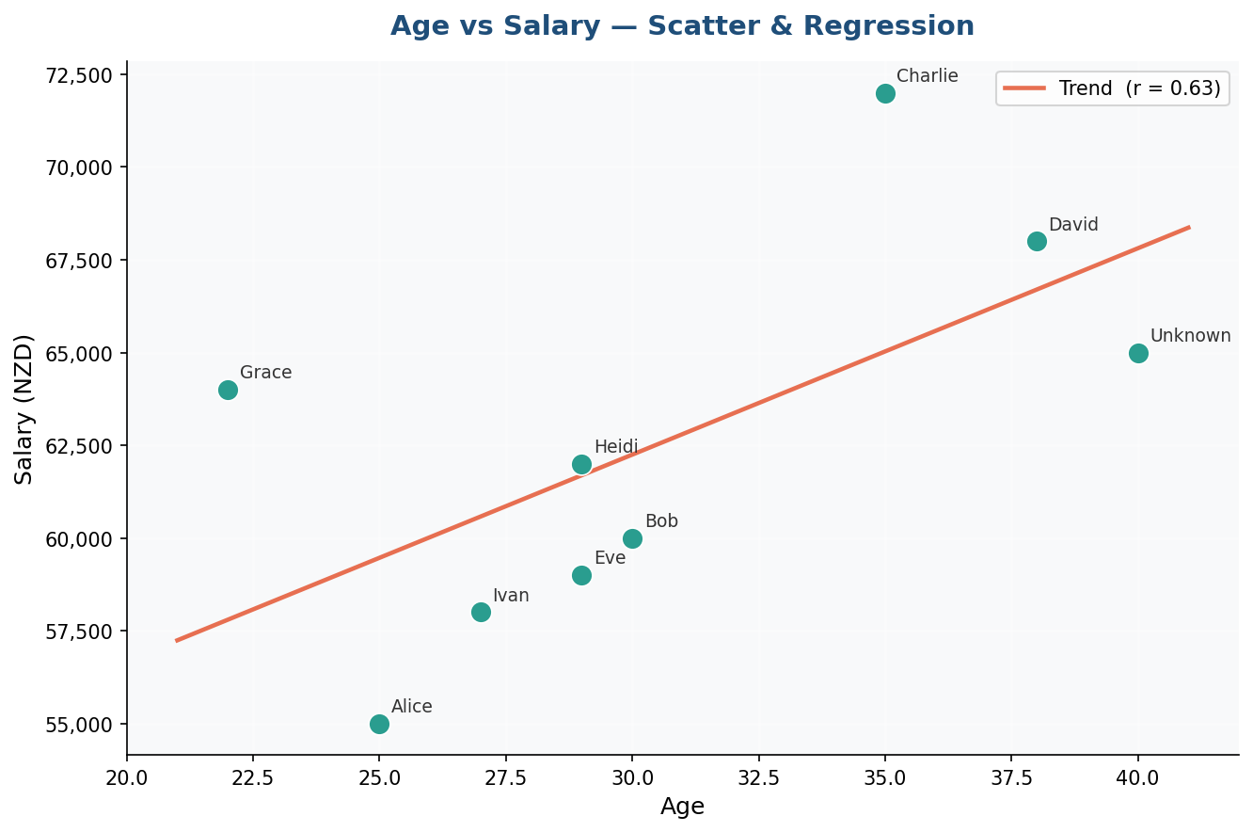
Age vs Salary — Scatter & Regression
Key Points
●
Each dot = one employee
╱
Red line = regression trend
↗
Line goes bottom-left to top-right
r
r = 0.64 shown in legend
✓
Confirms: older → higher salary
MSE-803 Data Analytics | Week 3 Activity 2

Slide 5
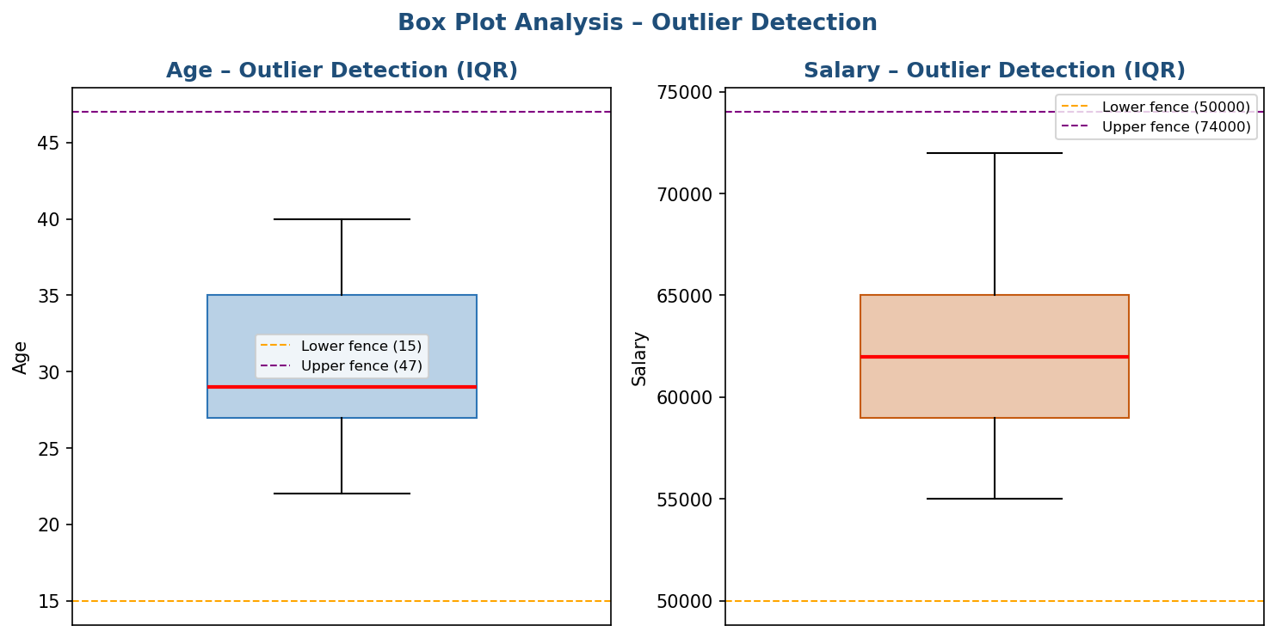
Outlier Detection — IQR Method
IQR Method
IQR = Q3 − Q1
Fence = Q1 − 1.5×IQR to Q3 + 1.5×IQR
Values outside fence = Outliers
Column | Lower Fence | Upper Fence | Outliers
Age | 15.0 yrs | 47.0 yrs | None ✓
Salary | $50,000 | $74,000 | None ✓
✓ ZERO outliers found
in Age or Salary
All values fall within
normal IQR fences
MSE-803 Data Analytics | Week 3 Activity 2

Slide 6
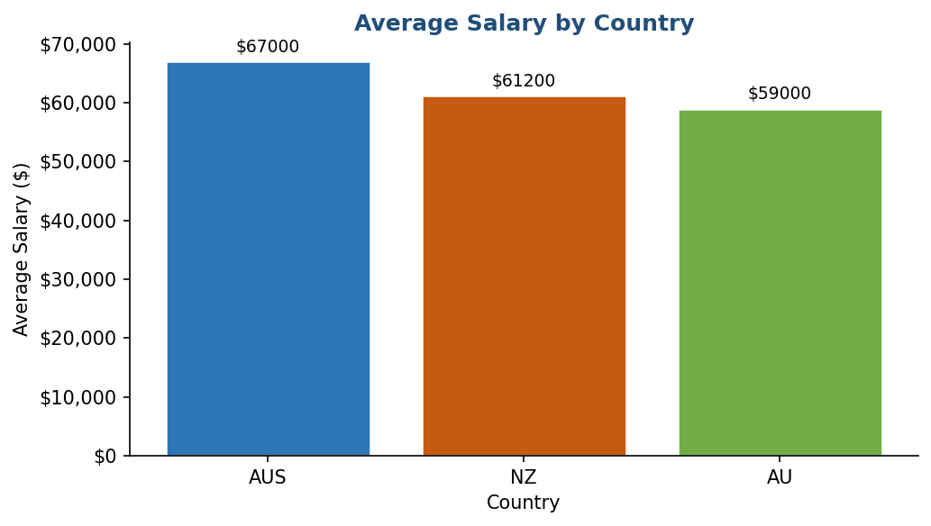
Average Salary by Country
Findings
🥇
AUS
Highest average salary
🥈
NZ
Middle range salary
🥉
AU
Lowest among known
MSE-803 Data Analytics | Week 3 Activity 2

Slide 7
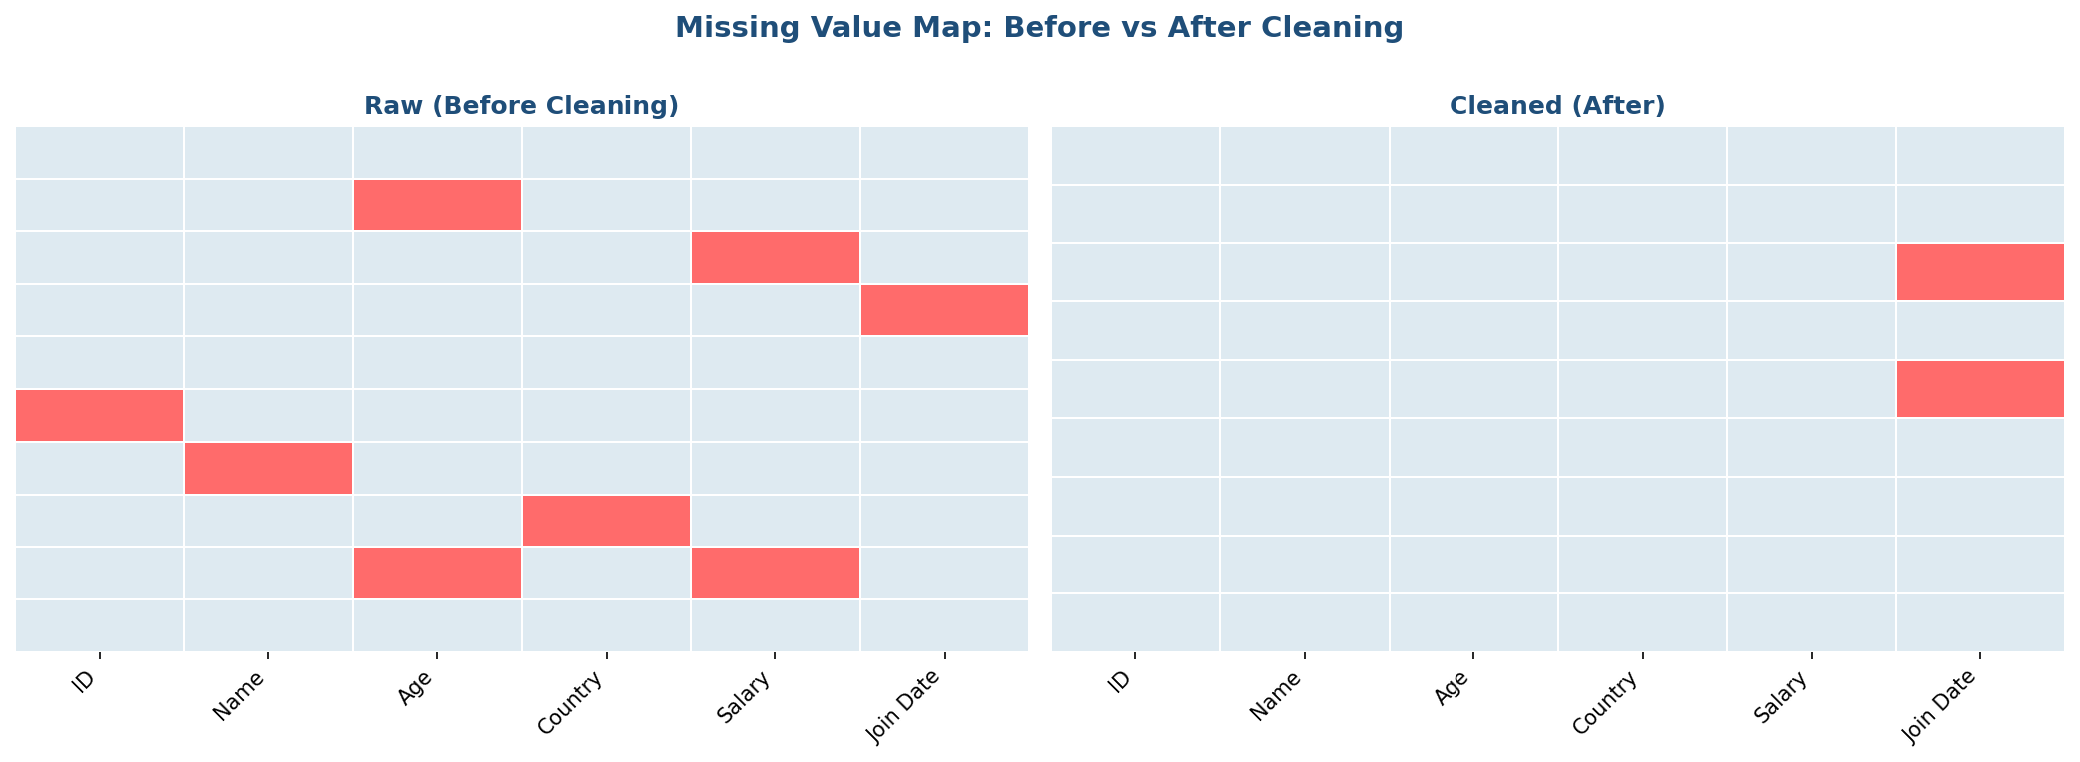
Missing Value Map — Before vs After Cleaning
Red = Missing value
Light blue = Data present
After cleaning: almost no red cells
One Unknown Join Date remains (unfixable)
MSE-803 Data Analytics | Week 3 Activity 2

Slide 8
Key Findings
✓
Data was messy but fixable — 10 problems found and all fixed with Python
✓
Age and Salary have MODERATE POSITIVE correlation: r = 0.629
✓
Older employees tend to earn more salary
✓
ZERO outliers found — IQR method confirms all values are normal
✓
Australia (AUS) pays the highest average salary
✓
⚠
Warning: Only 9 rows of data — larger dataset needed for stronger conclusions
MSE-803 Data Analytics | Week 3 Activity 2

Slide 9
Conclusion
10 data quality problems were identified and all fixed using Python
Pearson r = 0.629 shows moderate positive relationship between Age and Salary
IQR outlier detection confirms no extreme values in the dataset
6 professional charts were created and embedded in a formatted Excel workbook
The code is clean and modular — each section has one clear responsibility
Lesson: Clean data + correct method + adequate sample size = reliable analysis

